Slide 1
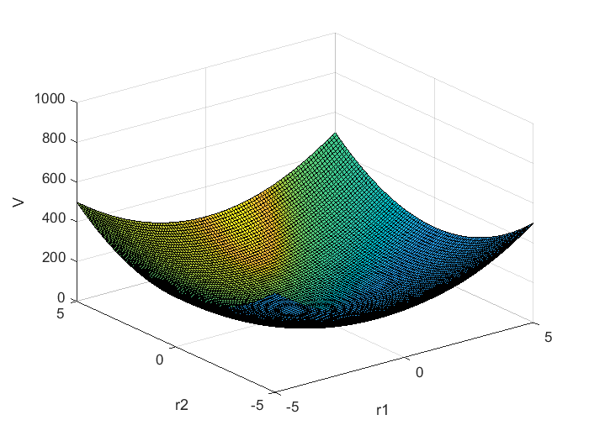
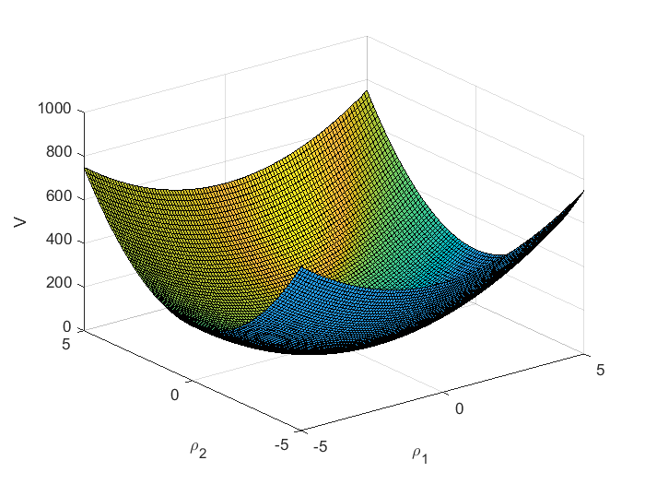
What is the meaning of the terms in the force constant matrix (FCM) ?
2D example
We have the potential energy in the quadratic form
V$=\left(\begin{matrix}1 & ρ2\end{matrix}\right)∗\left(\begin{matrix}f11 & f21 \\ f12 & f22\end{matrix}\right)$*$\left(\begin{matrix}1 \\ 2\end{matrix}\right)$
This function is a paraboloid in ρ₁ and ρ₂. We plot some examples
1) Only main diagonal, same f:
fcm=[10 0;0 10];
v1=r1.^2*fcm(1,1)+r2.^2*fcm(2,2)+r1.*r2*fcm(1,2);
[r1 r2]=meshgrid(-5:0.1:5);
surfl(r1,r2,v1); zlim([0 1000]);
xlabel('\rho_1'); ylabel('\rho_2');zlabel('V');
FCM=$\left(\begin{matrix}10 & 0 \\ 0 & 10\end{matrix}\right)$
2) Only main diagonal, different f:
fcm=[10 0;0 20];
v2=r1.^2*fcm(1,1)+r2.^2*fcm(2,2)+r1.*r2*fcm(1,2);
[r1 r2]=meshgrid(-5:0.1:5);
surfl(r1,r2,v2); zlim([0 1000]);
xlabel('\rho_1'); ylabel('\rho_2');zlabel('V');
FCM=$\left(\begin{matrix}10 & 0 \\ 0 & 20\end{matrix}\right)$

Slide 2
It turns out that one can see the effect of the terms in the force constant matrix better in contour plots than in 3D plots
The following page contains several cases
One sees that off-diagonal elements cause the paraboloid to rotate !
It is still a paraboloid, though, and we are still in the harmonic approximation
The code for one of the contour plots is given below:
fcm=[10 -10;-10 20];
[r1 r2]=meshgrid(-5:0.1:5);
v6=r1.^2*fcm(1,1)+r2.^2*fcm(2,2)+r1.*r2*fcm(1,2);
contourf(r1,r2,v6); axis square; colorbar;
xlabel('\rho_1'); ylabel('\rho_2');

Slide 3
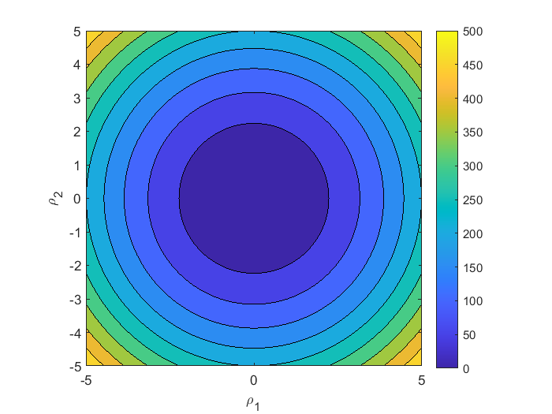
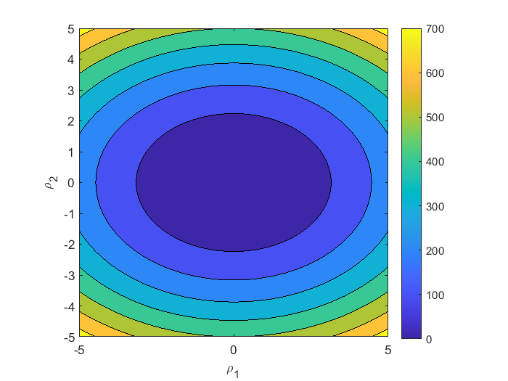
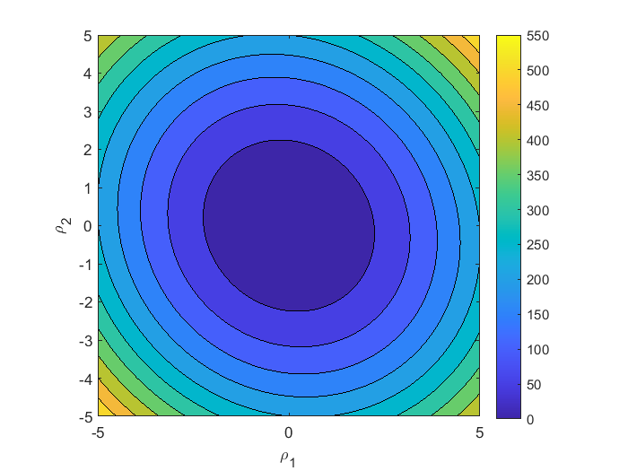
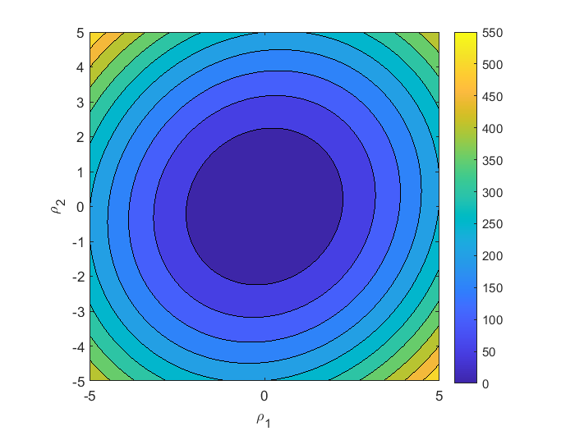
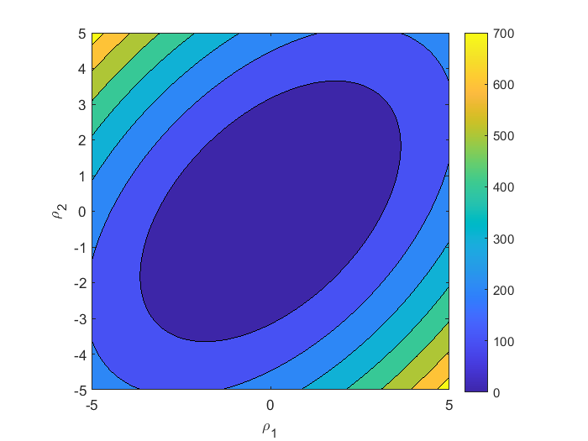
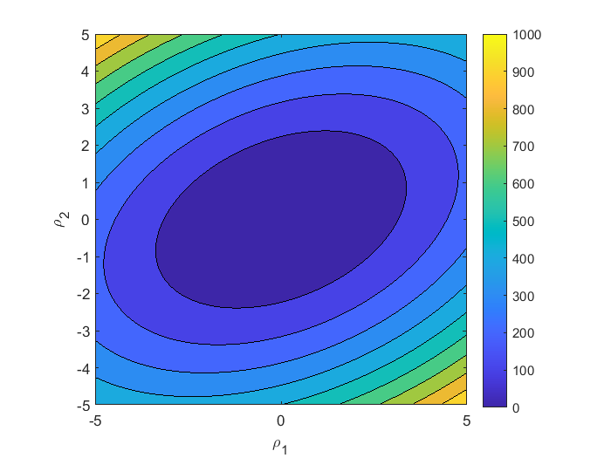
FCM=$\left(\begin{matrix}10 & 0 \\ 0 & 10\end{matrix}\right)$
FCM=$\left(\begin{matrix}10 & 0 \\ 0 & 20\end{matrix}\right)$
FCM=$\left(\begin{matrix}10 & 2 \\ 2 & 10\end{matrix}\right)$
FCM=$\left(\begin{matrix}10 & −2 \\ −2 & 10\end{matrix}\right)$
FCM=$\left(\begin{matrix}10 & −10 \\ −10 & 10\end{matrix}\right)$
FCM=$\left(\begin{matrix}10 & −10 \\ −10 & 10\end{matrix}\right)$

